Slide 1
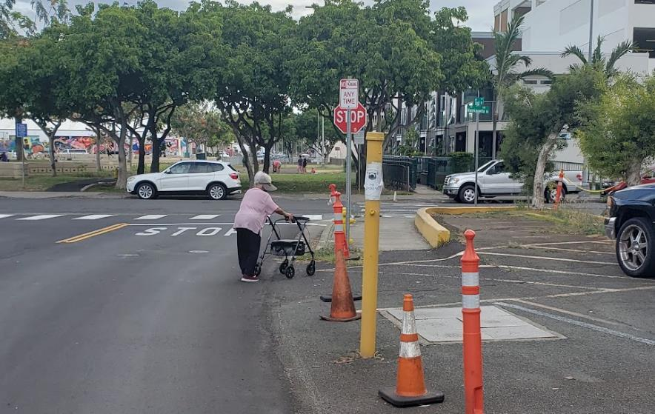
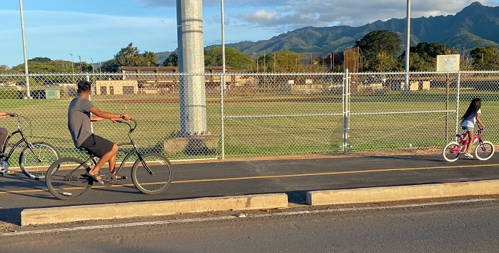
Making Progress towards
Better Streets & Healthier Communities
City and County of Honolulu
October 25, 2023

Slide 2
Honolulu’s Complete Streets Progress
2009
2012
2014
State legislation requires counties to have a Complete Streets policy
Complete Streets Ordinance adopted by Honolulu City Council (ROH 14-18)
CS Implement. Study begins
Age-Friendly City Initiative
2016
City and County Complete Streets Design Manual
2017
Biki launch
S. King Street Protected Bikeway opens
Program Administrator position created
Policy, Planning, and Major Milestones
2019
2020
Oahu Bike Plan updated
Honolulu’s first new transit lane since 1988 on King Street
Honolulu joins the National Assoc. of City Transportation Officials (NACTO)
2018
2022
Final Oahu Pedestrian Plan Adopted
City establishes new walkway improvement program
City’s first RRFB installed

Slide 4
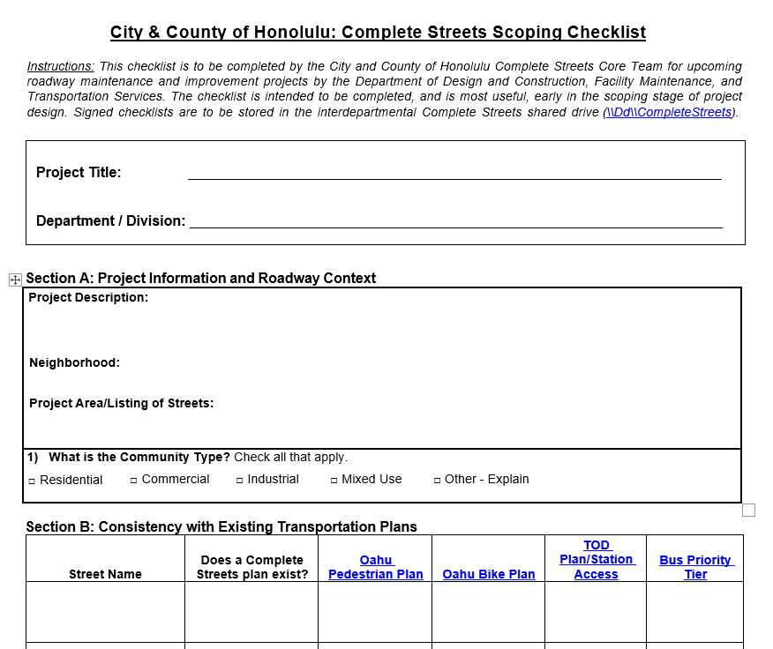
Complete Streets Core Team
Jurisdiction over City streets is shared between multiple departments
Transportation Services: transit, planning, operations
Facility Maintenance: maintenance, stormwater
Design and Construction: capital and rehabilitation projects
Planning and Permitting: private development, permitting
Parks and Recreation: street trees
Interdepartmental group meets twice a month to coordinate street activities and projects
Overseen by (civil-service) Complete Streets Administrator who reports to four department Directors who convene periodically to provide guidance

Slide 5
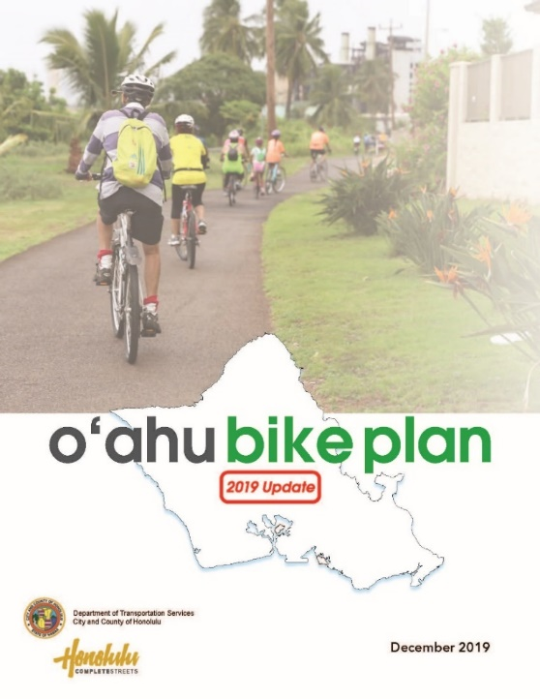
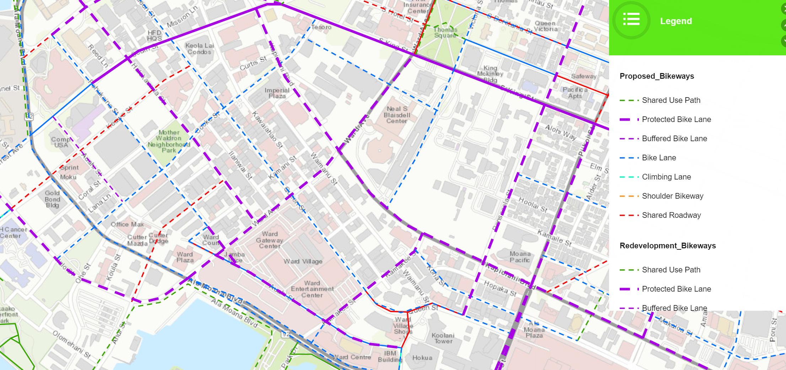
Bicycle Facility Improvements

Slide 6
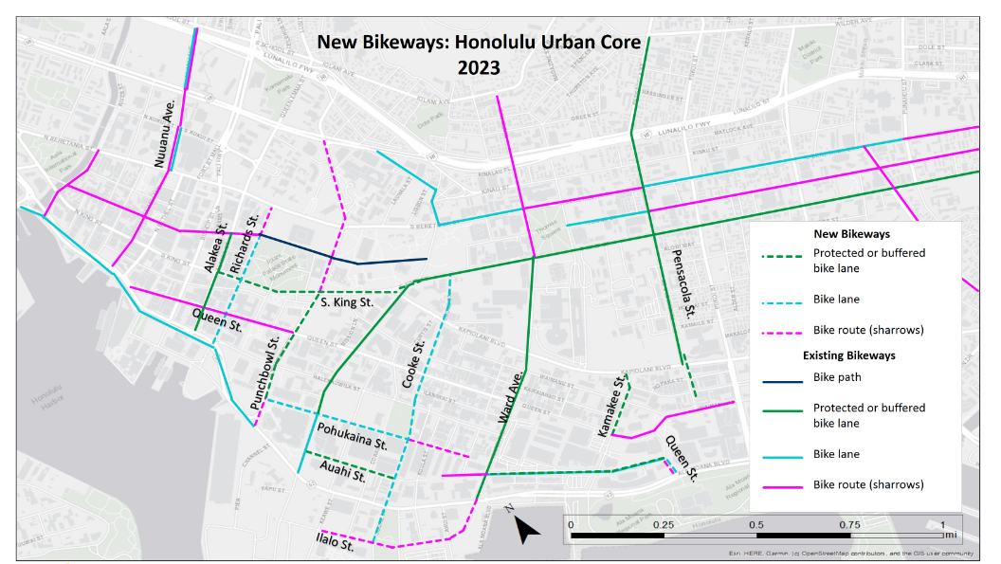

Slide 7
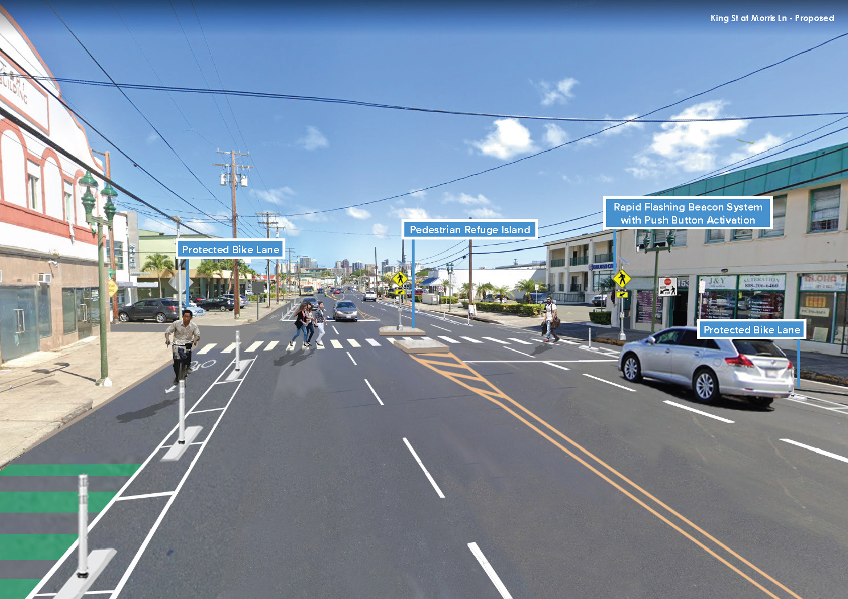
Stand-Alone
Bikeway Projects
North King Street
Haleiwa Road
Waipahu Depot Street
Keolu Drive

Slide 8
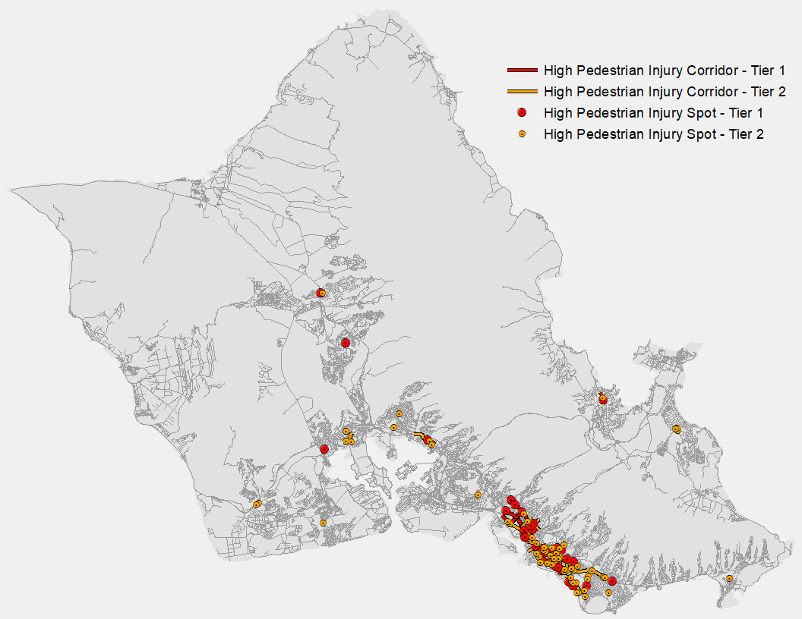
The City & County of Honolulu’s first pedestrian master plan
Highlights
Islandwide pedestrian inventory
High Pedestrian Injury Corridors and Intersections/Crossing
Pedestrian Priority Network
Priority walkway project list
Infrastructure and non-infrastructure actions

Slide 9
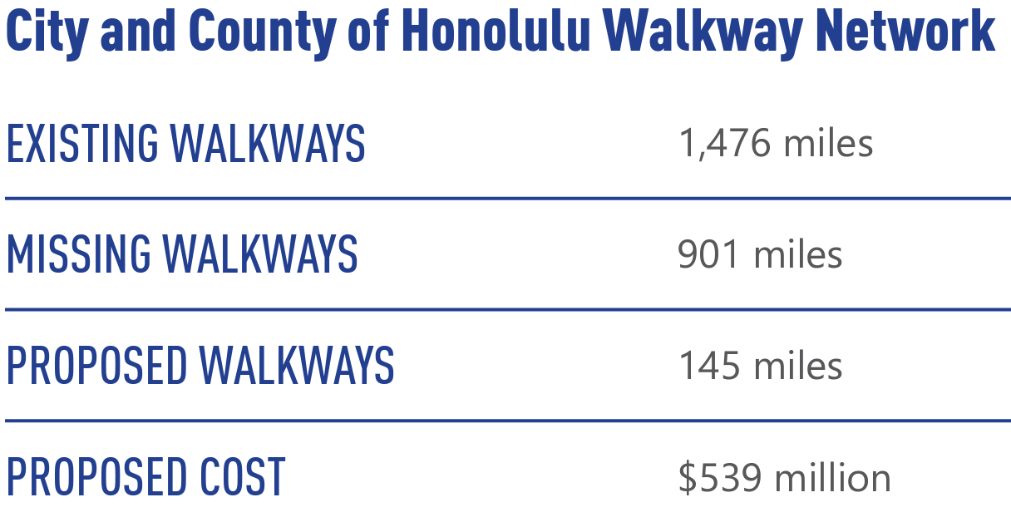
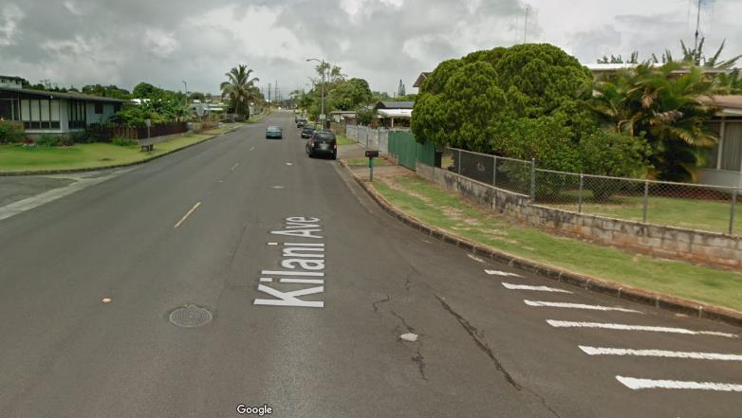
The Challenge
The Pedestrian Plan identifies over 900 miles of missing walkways on local roadways.
People walking make up 36% of traffic fatalities, esp. kupuna and low-income residents.

Slide 10
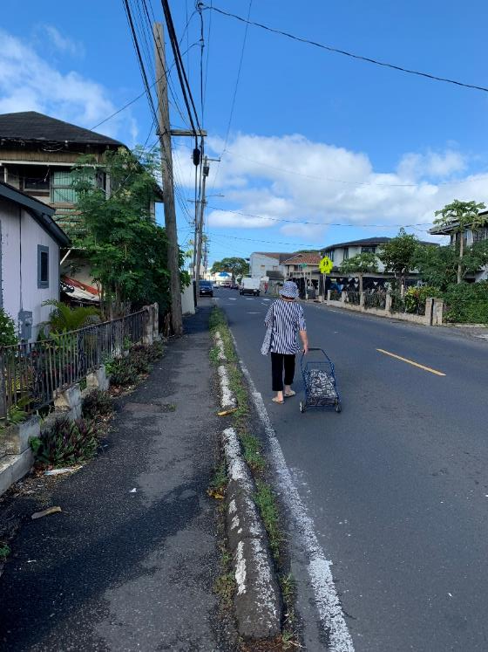
The Opportunity
Historic levels of federal transportation funding are available for Complete Streets and roadway safety projects
The City’s Safe Streets for All Program will plan, design, and construct high-priority missing walkways and other roadway improvements recommended in the Pedestrian Plan
The program will start with a small set of priority projects in communities of need
New projects will be initiated on a rolling basis as projects advance and are completed.

Slide 11
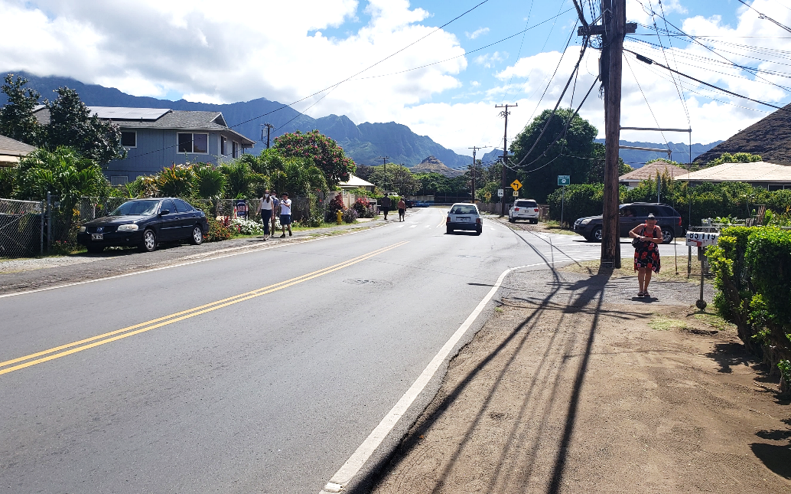
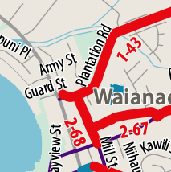
Project: Central Waianae Walkway Improvements
Plantation Road (Tier 1)
Connects Central Waianae to Waianae Elementary School and Pililaau Park
Previously identified for improvement by the Neighborhood Board and City Council
Mill Street (Tier 2)
Critical E-W spine through Central Waianae
Sporadic missing sidewalk segments on both sides of the street
McArthur Street (Tier 2)
Runs along the back side of Waianae Elementary School and multifamily housing
Sporadic missing sidewalk segments on both sides of the street
Plantation Road

Slide 12
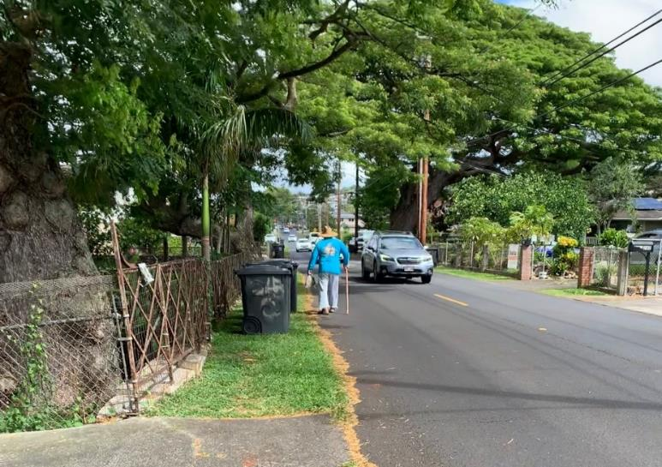
Management of Federal-Aid Projects
The City is working to embrace federal project processes (and funding!) which do take more time and effort
Hiring new dedicated project staff
Project Management Training program, supported by OahuMPO
Multi-term and Master Agreements Contracts for engineering and design services to reduce procurement time

Slide 13
ASK | LEARN | SHARE | CONNECT
www.honolulu.gov/completestreets
www.instagram.com/hnl.completestreets
Sign up for our mailing list
Comment online
Learn about Complete Streets projects
Get involved!

